Slide 1

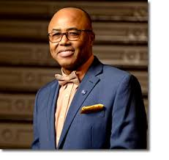
District 28
CEC Presentation
Superintendent: Dr. Eric L. Blake
Date: Thursday, February 5, 2026

Slide 2
District 28 Mission and Vision
Mission:
In Community School District 28 we focus on equity as a lever for achievement for every single scholar. We are a district of excellence. We commit to every school maintaining high academic standards and working closely with families so that all scholars are learning at high levels. Beginning with school leaders, teachers, students and community partners, we also commit to being a district of learners ensuring that we promote critical thinking rooted in core content conceptual understanding through creative problem solving, technology innovation, social emotional learning and community advocacy.
Vision:
In Community School District 28 we celebrate our differences because we understand that woven into those differences is the knowledge that they offer us unlimited possibility to learn and expand our knowledge of and commitment to all humanity. We are beautifully diverse, varied; coming from countless racial, ethnic, language, and belief backgrounds. We commit to striving for inestimable contribution to the lives of our scholars.

Slide 3
D28 Superintendent Priorities
Improve outcomes in Mathematics by implementing a common research-based curriculum and introducing or scaling, where appropriate, Regents level courses for scholars
01
Improve literacy skills by implementing research-based, Science of Reading (SOR) HMH curriculum in all K-8 schools.
02
Work to substantially improve daily attendance and reduce chronic absenteeism.
03
Continue to increase Parent and Family Engagement and Community Partnerships.
04

Slide 4
D28- District Non-Negotiables
Standards-Aligned Instruction: All lessons must be aligned to grade-level standards and learning objectives.
Small Group Instruction
Explicit Teaching with Gradual Release: Teachers model, guide, and then release responsibility for independent practice.
Active Student Engagement: Students are consistently engaged through questioning, discussion, and checks for understanding.
Data-Driven Differentiation: Instruction is adjusted based on formative assessment to meet diverse student needs within the core lesson.

Slide 5
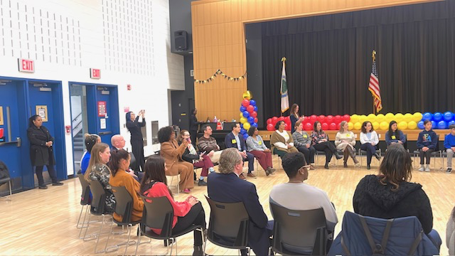
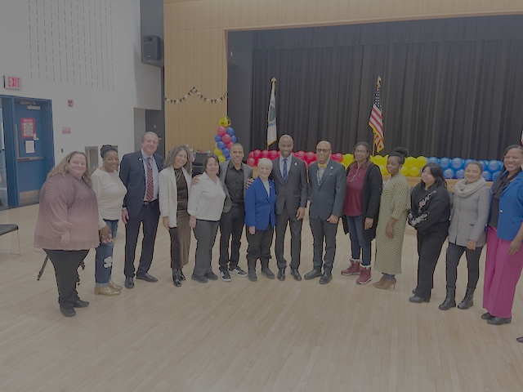
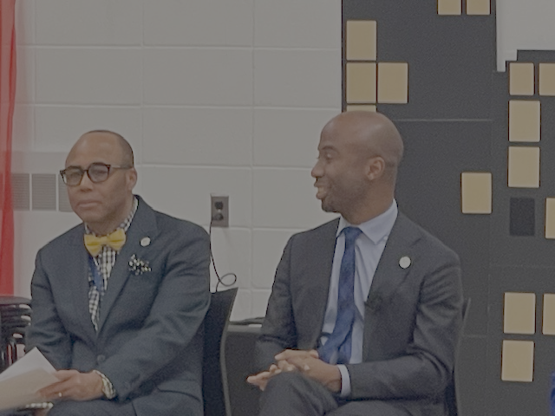
Chancellor’s Visit to D-28
District 28 extends our heartfelt thanks to Chancellor Kamar Samuels and his team for visiting PS 303 and spending time with our scholars, families, and staff. We are deeply grateful to all of our D28 stakeholders—students, parents, staff, SLT, PTA, CEC, PEP, and our elected officials—whose partnership and presence made the visit truly meaningful. Together, we continue to strengthen our community and advance the work that supports every child’s success.

Slide 6
Protocols for Non-Local Law Enforcement
NYCPS, the Mayor’s Office, and District 28 take the safety and rights of all students extremely seriously, especially regarding non‑local law enforcement and ICE. Schools remain protected spaces, and ICE or other non‑local agencies are not permitted to enter unless legally required with a valid judicial warrant, which must be reviewed by Senior Field Counsel before any action is taken. If such personnel appear, staff follow strict DOE protocols to keep officers outside, notify leadership, and ensure no student is questioned or detained. District 28 continues to reinforce these protections through principal training and Know Your Rights resources for families. Links to these protocols as well as resources are shared on both the DOE and the D28 website.

Slide 7

D28 SHOUT OUT!
A national study by The 74 (a non-profit covering education nationwide) examined 41,883 schools and identified the ones whose third‑grade reading proficiency exceeded expectations based on poverty levels. I am pleased to announce that District 28 stands out with 21 schools represented, showcasing exceptional early literacy results and a deep commitment to helping our young readers thrive. With early reading strongly linked to long‑term academic success, this recognition underscores the powerful work happening across our D28 school community.
Schools: 121, 303, 101, 144, 174, 99, 140, 48, 55, 54, 80, 161, 160, 312, 40, 50, 86, 175, 139, 349

Slide 8

D28 Celebrates Black History Month
District 28 Elementary and Middle Schools are celebrating Black History through bringing Black Studies curriculum to life, ensuring all students see their history reflected in their daily learning. We are proud to extend these lessons into the community by partnering with our 12 MBK/MSK schools for gratitude events that foster real-world connection and service.

Slide 9
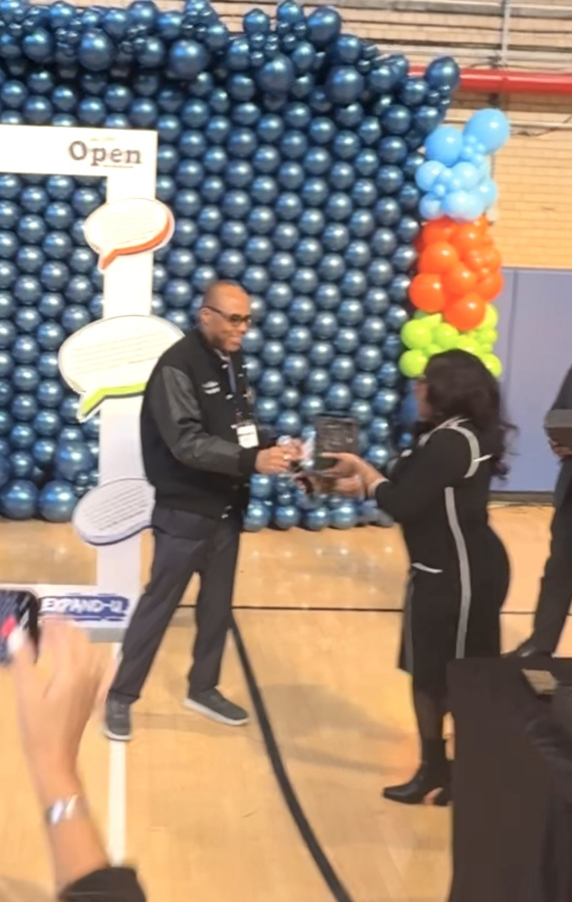
MWBE (Women and Minority Owned Business Enterprise )
District 28 is proud to be honored as one of only five districts citywide to meet its MWBE utilization target. Our team remains committed to deepening engagement with MWBE‑certified vendors by strengthening community partnerships, expanding outreach, and creating meaningful networking opportunities that align local businesses with district needs. We will continue supporting the MWBE community through capacity‑building efforts that help vendors meet program standards. Special thanks to Dr. Tammy Pate and her team for their steadfast leadership and support in this important work.

Slide 10

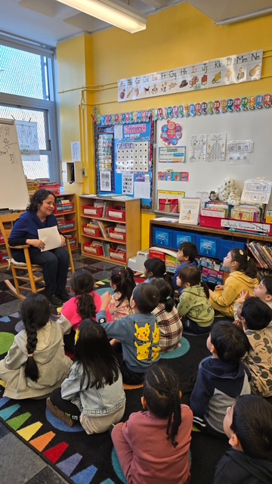

World Read Aloud Day at PS 220
District 28 schools proudly celebrated World Read Aloud Day, with members of the district team visiting classrooms to read with students and highlight the joy of storytelling. This collective effort reinforced the district’s commitment to literacy and community engagement.

Slide 11

Respect for All Week February 9-13
District 28 will observe Respect for All Week from February 9–13.
• Schools will promote kindness, empathy, diversity, and anti‑bullying efforts.
• District and superintendent teams will visit schools to support activities.
• Students will participate in assemblies and discussions on identity and inclusion.

Slide 12
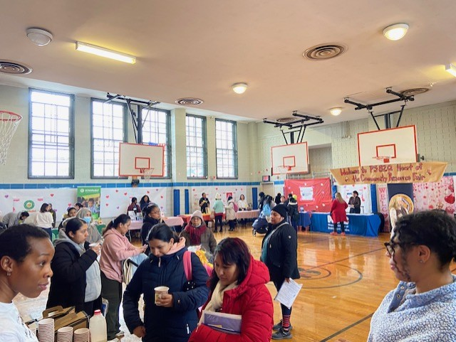

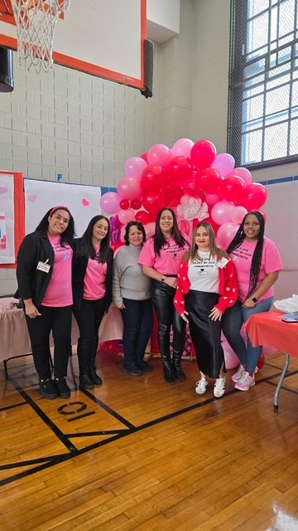
D28 Community Resource Fair at PS 82
💙 Heart of the Community Resource Fair at PS 82! PS 82 welcomed families and community partners for a vibrant Resource Fair filled with essential services that support well‑being, learning, and family engagement. District Family Leadership Coordinator Sonia Rueda joined the event, proudly supporting families and representing District 28 with dedication.

Slide 13
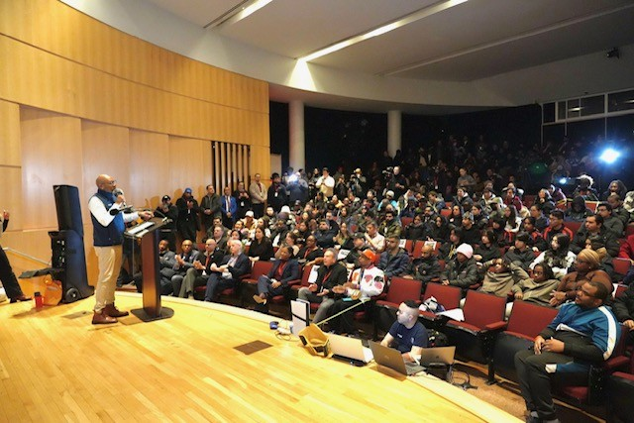



2026 Queens Tech and Career Expo
District 28 was proud to join Queens Borough President Donovan Richards’ Queens Tech & Career Expo at the New York Hall of Science — a free, high‑energy event showcasing technology, gaming, mentoring, and real career opportunities all in one place. In partnership with the QBP’s Director of Education, Ms. Kat Zapata, and AT&T, we were thrilled to provide 100 of our neediest families with brand‑new laptops, expanding access to technology across our community. We want to thank QBP, Donovan Richards for his continued support of our community.

